Slide 1
Take-Home Assignment: Senior Systems Integrator (Data Science and Visualization) (48634)
By Shafquat Arefeen

Slide 2
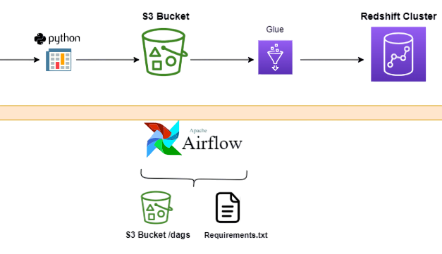


The Pipeline

